Slide 1
Proxy
Using a substitute/deputy

Slide 2
Proxy
A web page contains a lot of images, many of which will never be displayed as they are ‘at the end of the scroll’ where the average user do not see at all. Can we avoid downloading them?
Download on demand – i.e. only when they become visible

Slide 3
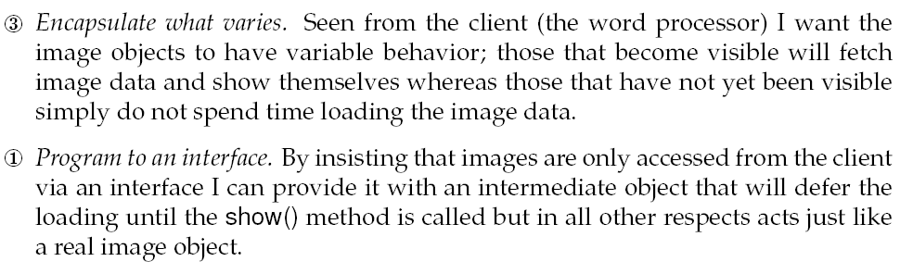
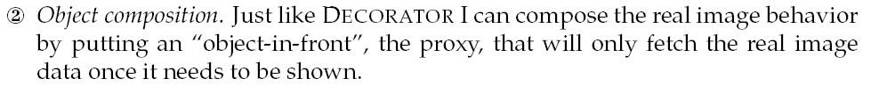
3-1-2

Slide 4
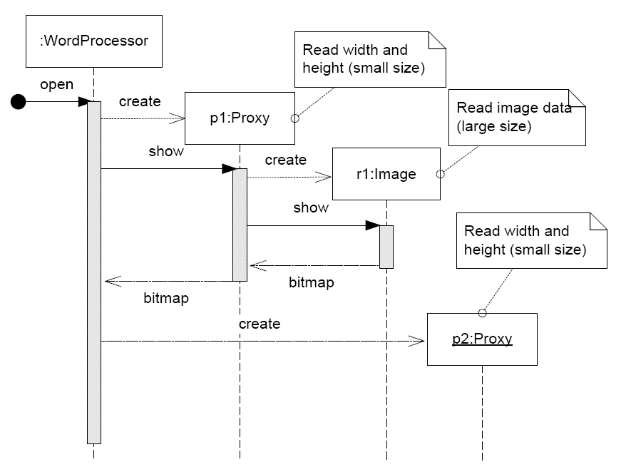
Dynamics

Slide 5
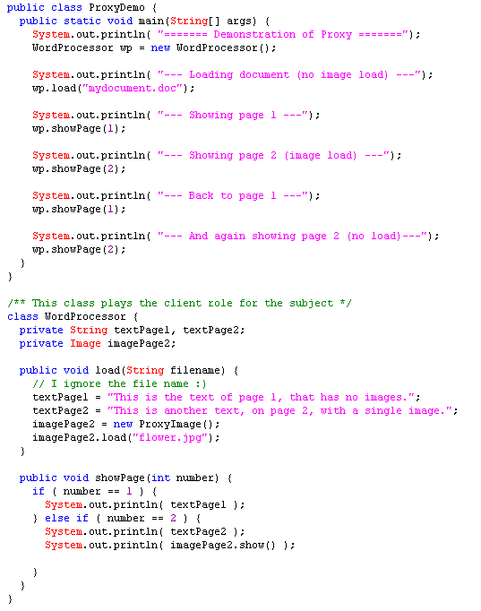
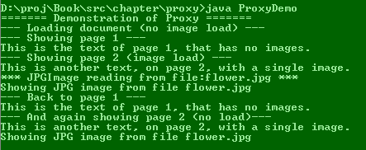
Demo

Slide 6
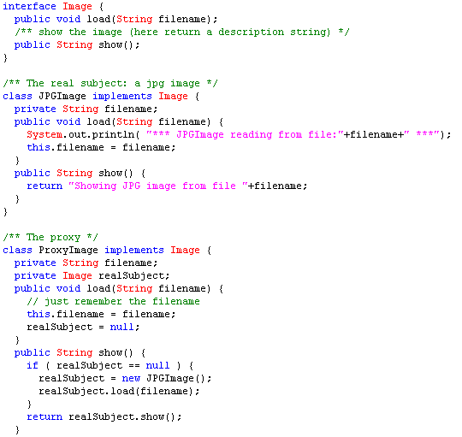
The Proxy itself

Slide 7
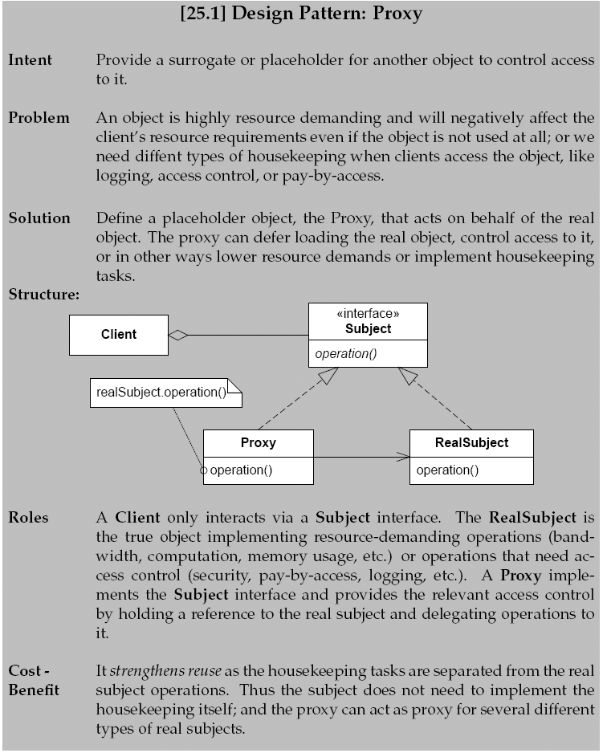
Proxy

Slide 8
Consequences
Benefits
  Supports all types of access control: deferred access, pay-by-access, logging, access control, …
  Decouples domain behavior and access control behavior (potential for reuse)
  Is the core technology in remote method invocation
    Java RMI
    .Net Remoting

